Slide 1
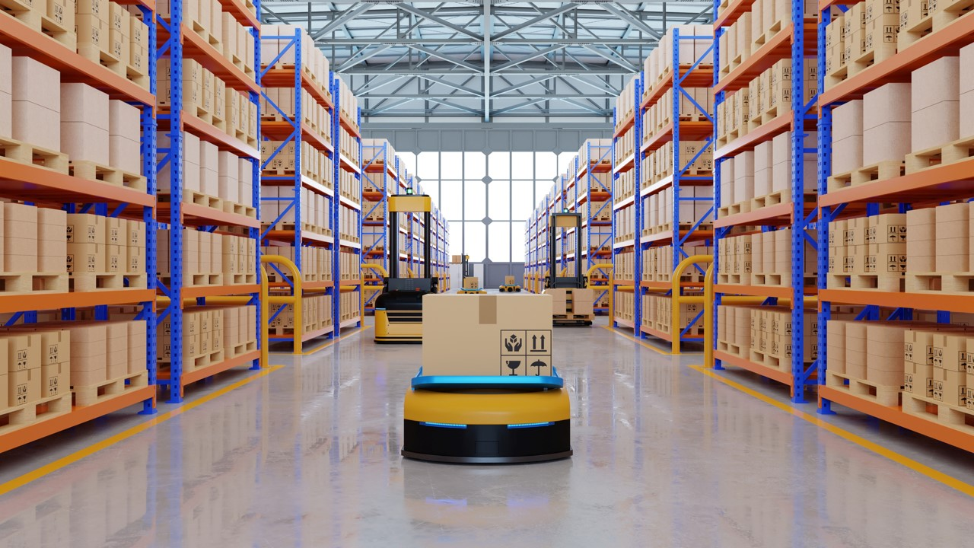
DAMG 6210
Warehouse Management System
Group 20:
Shuo Wang
Yucong Feng
Nishitha Surendran

Slide 2

Objectives
Summary:
Warehouse storage has always been in a very important position in society, and it is difficult for people to live without warehouse storage.
Example：
1. Amazon 2.IKEA 3.SuperMarket
Goal：
We want to build a practical warehouse storage system.
Help us further understand and explore warehouse storage.
Increase our experience of database projects.

Slide 3
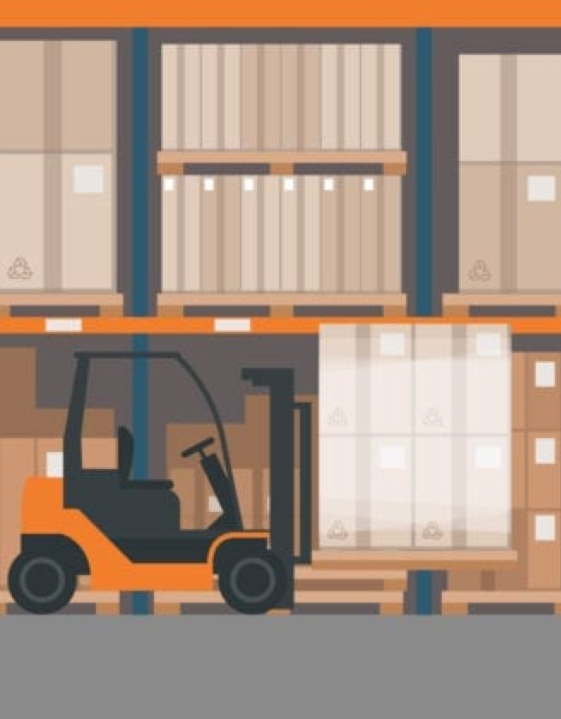
High Level Design

Slide 4
E-R Diagram

Slide 5
Database Objects
Non-Cluster
Index
Encryption
DDLs
Triggers
8
-Administrator
-Warehouse
-Product
-Supplier
-Customer
-Store
-InStock
-OutStock
4
-SupplierNumberHistory
-SupplierAddressHistory
-CustomerNumberHistory
-CustomerAddressHistory

Slide 6
Database Objects
Store
Procedures
DDLs
Views
UDF
4
-getAdminRecord
-CheckQuantityValid
-ProductInStock
-TakeProductOutStock
8
-Product_TotalStorage
-Warehouse_TotalStorage
-product_in_and_out_quantity
_within7days
-product_in_and_out_quantity
-Supplier_Product_Quantity
-Administrator_IN_Workload
-Administrator_OUT_Workload
8
-GetCustomerConactInfo
-GetCustomerAddressInfo
-GetSupplierConactInfo
-GetSupplierAddressInfo
-InStockTime

Slide 7
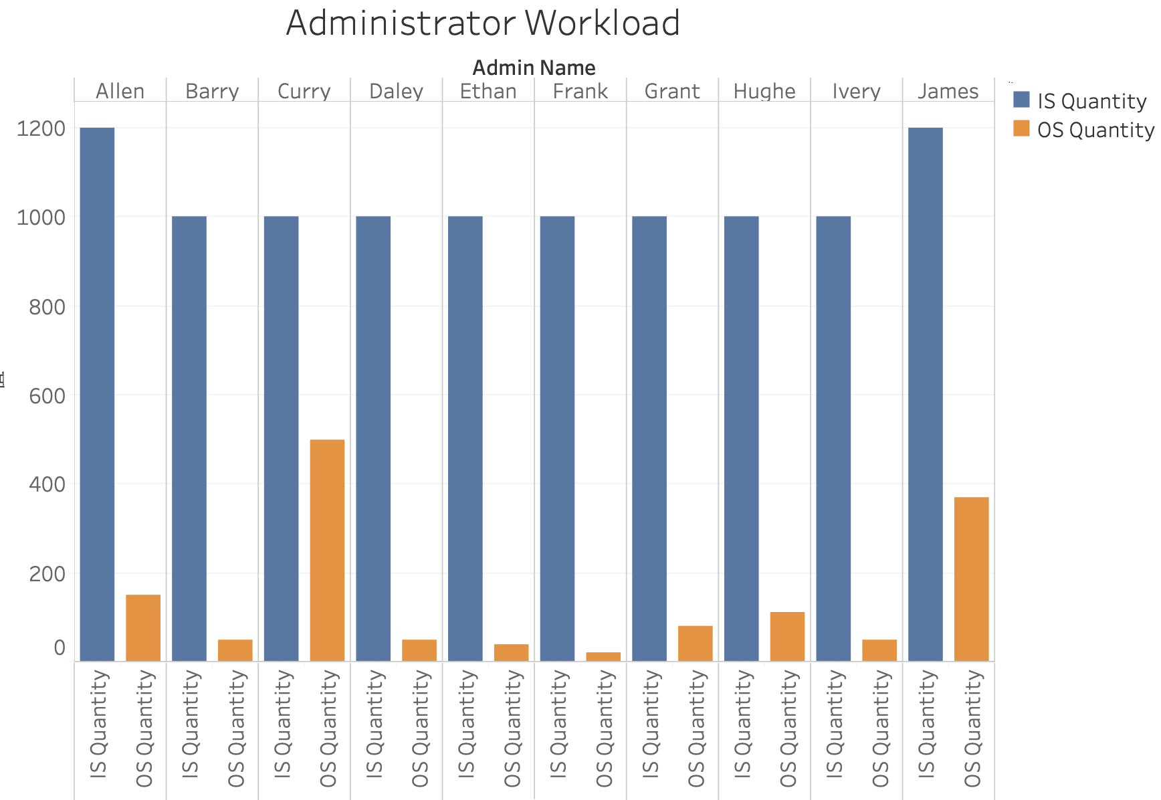
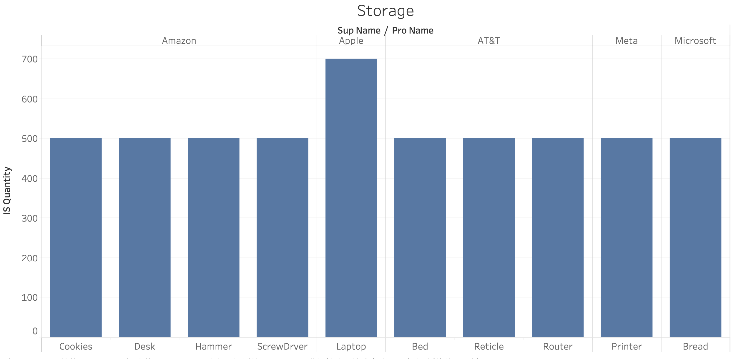
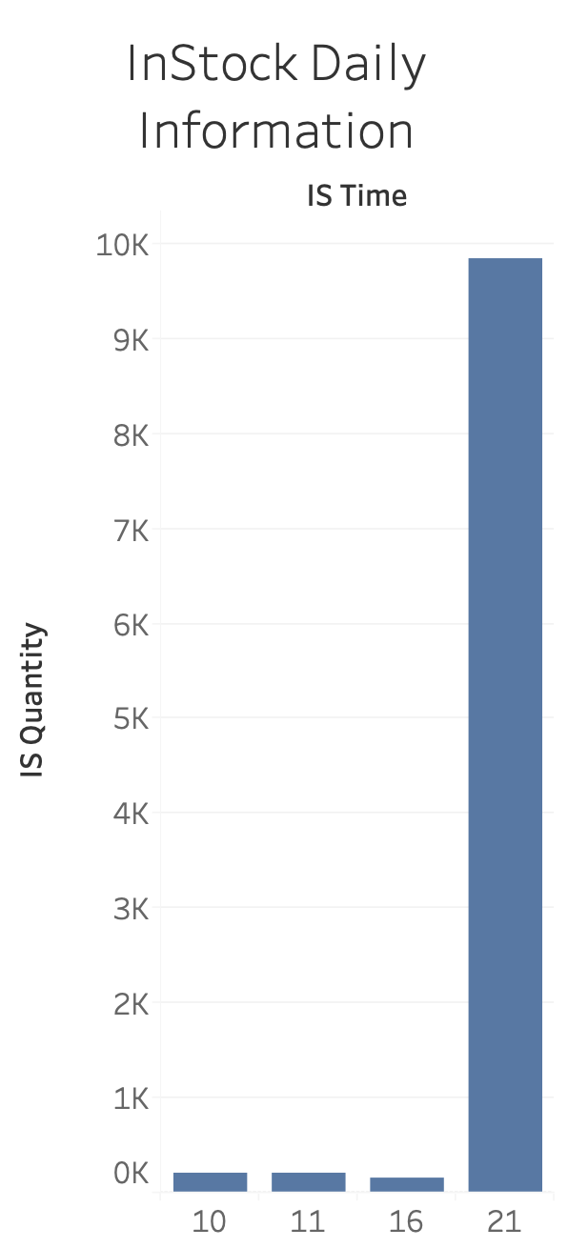
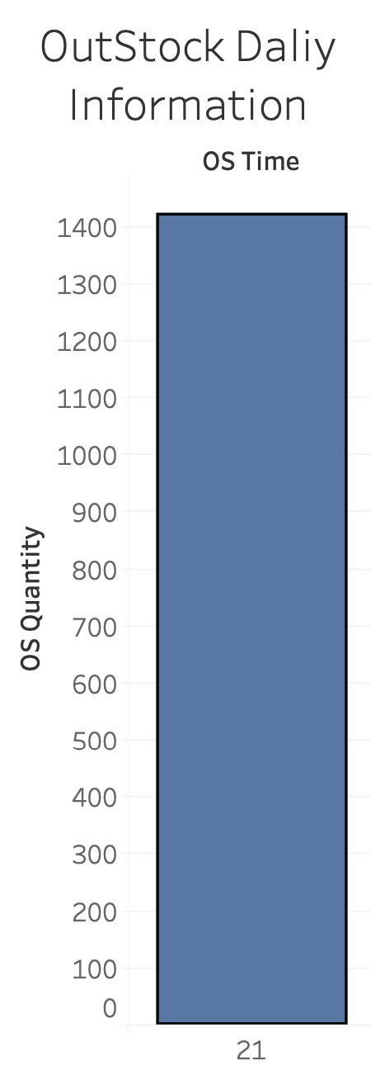
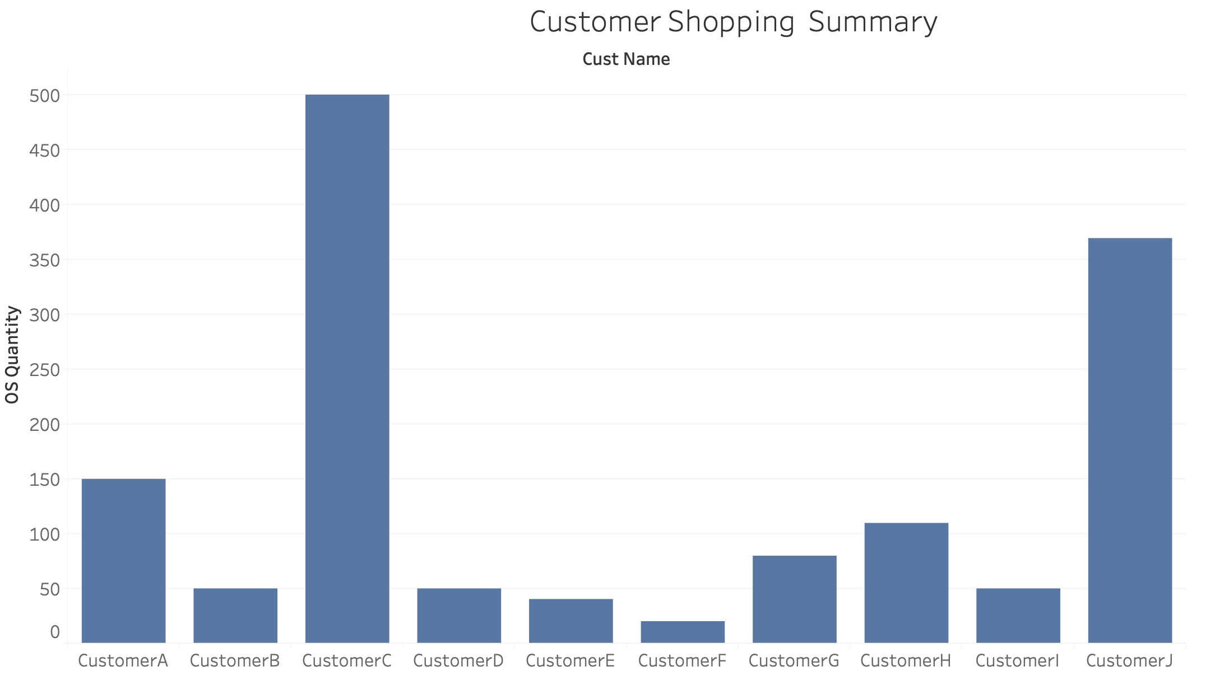
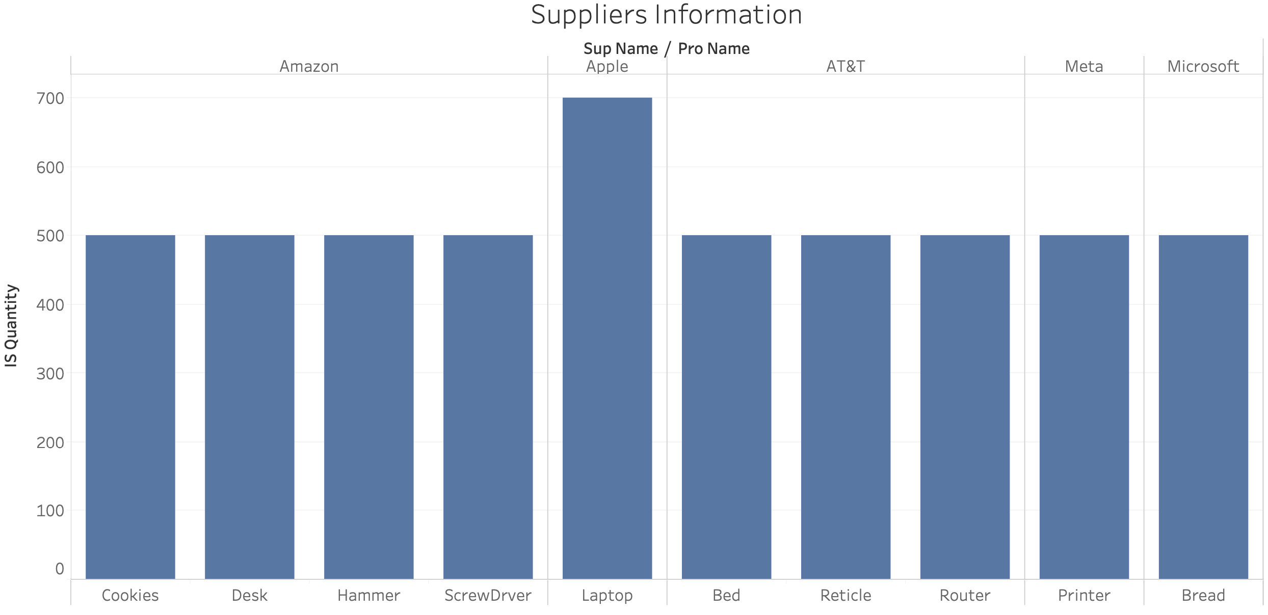
Visualization

Slide 8
Thank you~

